Slide 1
110 kV Vojnik S/S – Case Study.
mag. Blaž Pirnat
Martin Kotnik
ELES d.o.o., Secondary Systems Department

Slide 2
Introductionn
S/S Vojnik is a simple H type GIS S/S with two OHL lines, two 20 MVA Transformer and a section bay
due to the nature and topology of 110 kV network also in such a small substation a number of various communication is required between IED‘s. All required communication between the IED's are done with IEC6150 standard (Standard), either as a redundant or standalone route. This is a first substation in our network where that has been done.
complexity of the Tendering procedures IED’s of various vendors come into play and complexity for the commissioning process due to the different and non-homogenous interpretations of the standard,
we will discuss the valuable lessons learned in pinpointing the possible troubles and how to prepare future endeavours.

Slide 3
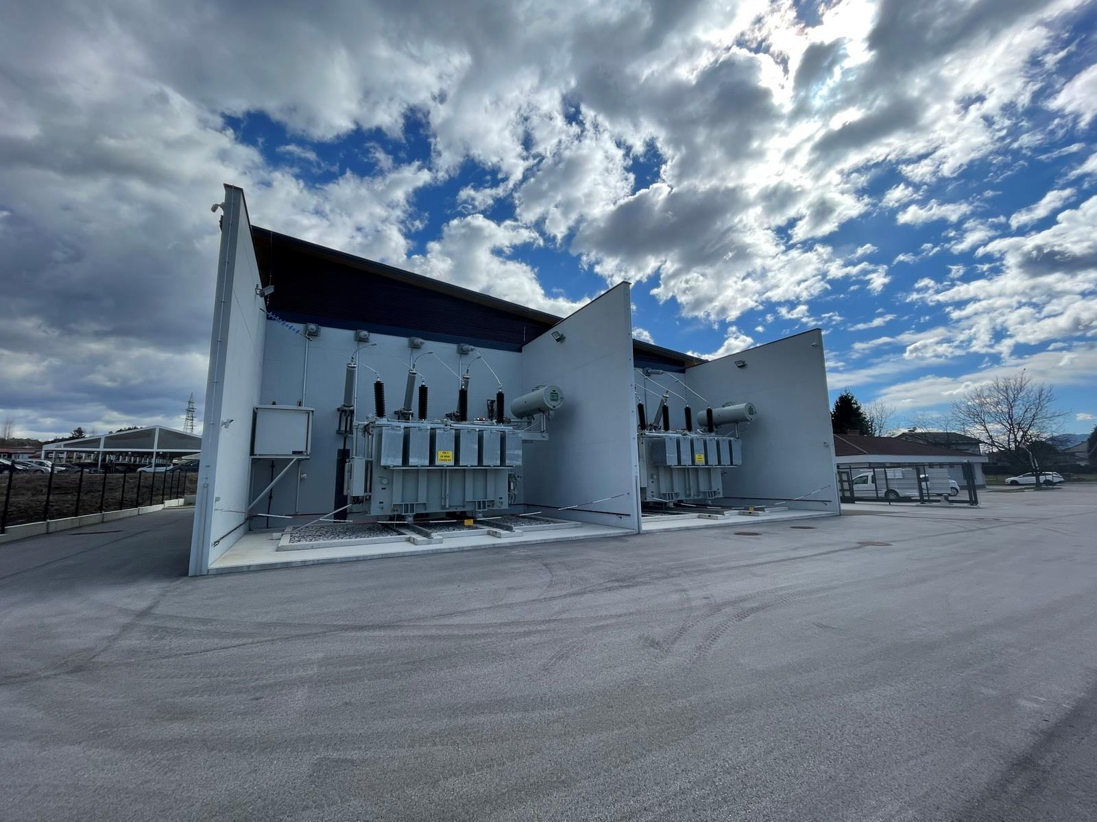
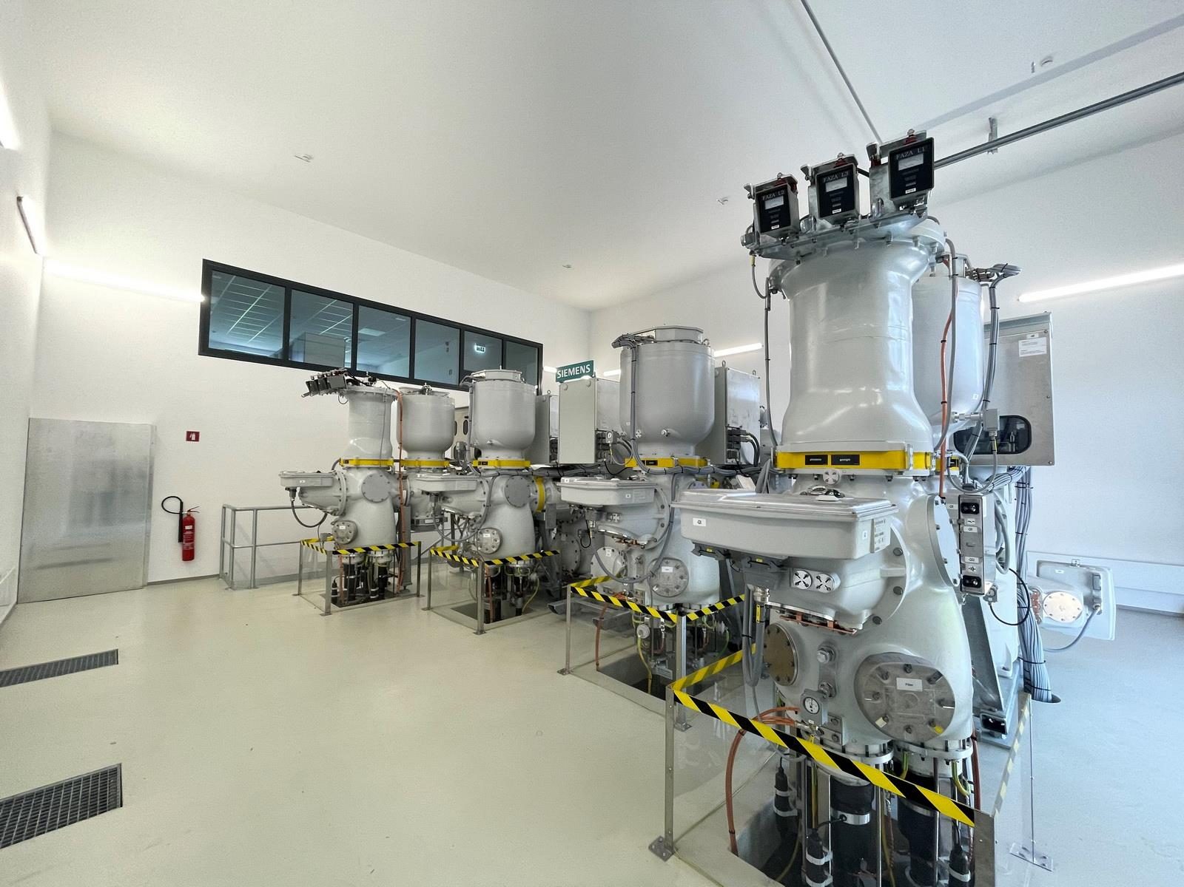

Slide 4
110 kV protection scheme – OHL line
Distance Protection
4 independent Quadrilateral Zones
PUTT scheme
AR is enabled exclusively for single pole faults
EF protection with directional comparison
two stage overcurrent protection
emergency overcurrent protection
For lines shorter then 5 km we use Line differential protection

Slide 5
110 kV protection scheme - busbar
Busbar protection
Two protected zones
Breaker failure protection
End Fault protection
Overcurrent protection (only for OHL bays)

Slide 6
110 kV protection scheme – teleprotection
Teleprotection device
MPLS network for direct connection to opposite side,
Send/Receive PUTT scheme signals
Send/Receive EF comparison signal
Send End Fault protection from BBP IED to the opposite side

Slide 7
Single Line Diagram

Slide 8
List of equipment
Distance protection
Toshiba GRZ200
Line Differential Protection
ABB RED670
Busbar Protection
Toshiba GRB200
Transformer Protection
ABB RET670
Teleprotection
Siemens SWT3000

Slide 9
GOOSE messages definition
 | E01 GRZ200 | E01 RED670 | E01 SWT3000 | E03 GRB200 | E05 GRZ200 | E05 SWT3000
E01 GRZ200 |  |  | x | x
E01 RED670 |  |  |  | x
E01 SWT3000 | x
E03 GRB200
E05 GRZ200 |  |  |  | x |  | x
E05 SWT3000 |  |  |  |  | x

Slide 10
Quality Bits explanation

Slide 11
Quality Bits explanation
MSG No. | Interval [ms] | Absolute time [ms]
1 | / | 0
2 | 4 | 4
3 | 8 | 12
4 | 16 | 28
5 | 32 | 60
6 | 64 | 124
7 | 128 | 252
8 | 256 | 508
9 | 512 | >1000

Slide 12
Quality Bits explanation
Quality Bit | Meaning
Overflow | Value beyond the capability of being represented properly
OutOfRange | Value beyond a predefined range of values
BadReference | Value may not be correct due to reference is not calibrated
Oscilatory | Signal change within a defined time twice in the same direction
Failure | Internal or external failure detected by supervision
OldData | Fail to update data within specific time interval
Inconsistent | Evaluation function reports inconsistency
Inaccurate | Value does not meet the stated source accuracy
 | As per IEC61850 |  | Recommended
Quality Bit | Invalid | Questionable | Invalid | Questionable
Overflow | x |  | x
OutOfRange | x | x |  | x
BadReference | x | x |  | x
Oscilatory | x | x |  | x
Failure | x |  | x
OldData |  | x |  | x
Inconsistent |  | x |  | x
Inaccurate |  | x |  | x

Slide 13
Lessons learned
Functional description
Standard defines a vast number of Data attributes
end user must define in advance what he will use and publish
Vendor interpretations
We need to understand the Vendor interpretations of Quality Bits and Validity Attributes
is crucial that already in the bidding or buying phase IED’s are offered with the corresponding data.
IED configuration
IED’s must enable the tools to define the actions (or reactions) in case of Questionable Validity Attributes.
Protection engineer must have the ability to define the reaction of the IED

Slide 14
Lessons learned
Network engineering
network engineering is mandatory
use of dedicated VLAN addresses and Switch Port mapping can help us diminish (yet not totally exclude) intolerable time latency.
Testing, Simulation and Test Tools
we must perform functional acceptance tests of each IED
extensive use of Simulation and Test tools at all project stages is mandatory to gain understanding and the behaviour of used equipment
we must be able to analise the network traffic, register time delays, monitor and track particular IED’s reactions and simulate the behaviour of either part or entire protection functionalities
We use IED Scout 5.0 and Wireshark 3.2.

Slide 15
Conclusion
The Vojnik S/S has shown us the need to diminish the non-homogenous reactions of the protection schemes even in a small sized S/S.
If the problem is not solved in time will arise and escalate with each subsequent step in the project.
As an end user, we need to be a step forward in understanding the standard.
With all that we can use the standard and achieve all protection features, that our older colleagues could achieve using wiring alone.

Slide 16
Thank you for your attention

